Slide 1


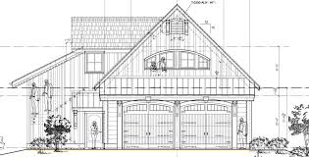
Career Research Assignment
Architect
Jimmy Stevens
Technology 7
Mr. Poliszuk

Slide 2


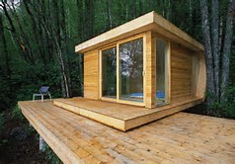
Architect
Job Description
Architects plan and design houses, office buildings, and other structures.
Education Needed
Bachelor’s degree
Pay
$73,090 per year

Slide 3
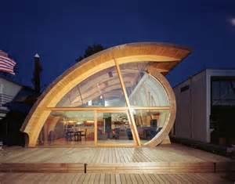
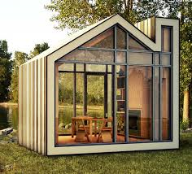
Architect
Skills Needed
Analytical skills
Communication skills
Creativity
Organizational skills
Technical skills
Visualization skills
Work Environment
Architects spend a lot of their time in an office or at home on their drawings. They often meet with clients, develop reports and work with other architects and engineers.
Pros/Cons
Pros
$73,090/year
Fun to be creative
I like to design and build things
Cons
Long work days
Difficult to find a company to work for
Can be difficult to find clients

Slide 4


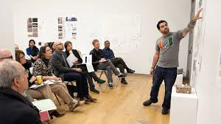
Architect
College/school for education
Rhode Island School of Design
Tuition Cost
$44,284 per year
Middle School Classes to Help Prepare Me
Art
Technology
Math
Science
Reading
Social Studies

Slide 5
Exit Questions
Which job characteristics are most important to you when deciding on a career?
How many years of schooling for the following college degrees:
Associates (undergraduate) -
Bachelors (undergraduate) -
Masters (graduate) –
Doctoral –
How can middle/high school help prepare you for a career?
What are the top 10 skills valued by employers?
Which 3 skills do you feel are most important to have? Why?
How can you improve your skills needed for your career?

Slide 6



Conclusion
After researching this career, I would still like to become an architect. I would like to become an architect because I think it is fun to draw and to be creative. I think it would be fun to design houses for other people. It pays well and I would only have to go to school for four years to become an architect. I could support a family and buy my own house with the money I would make being an architect.

